Slide 1
Solar House Experiment
By: Jenna VanderSluis- Hoogstra Spring 2013

Slide 2
The Experiment
Background Information
Passive solar heating works like this: light goes through windows and gets absorbed by the contents inside the house or car. At this point the energy is radiated as heat which can’t get through the window as easily. By this process, the house heats up--this is called the greenhouse effect.
Materials
solar house model, thermometer, timer

Slide 3
Formative Assessment !
Big Idea Questions
Have you ever gotten in a car on a cold and sunny day only to find out that the inside of the car is warm? What about a car in the summer?
Why do you think the inside of the car is warmer than it is on the outside of the car?
How does the inside of the car get heated up?
Do you think that anything on the inside of the car affects it heating up?

Slide 4
The Experiment
The topic I taught my class for this final project was about the greenhouse effect. My class has been studying the Ancient Mayans and Incans and how they worshiped and relied on the sun, so I thought by conducting some experiments my class could discover why these ancient cultures worshiped the sun. To aid us in this study my students build solar houses.

Slide 5
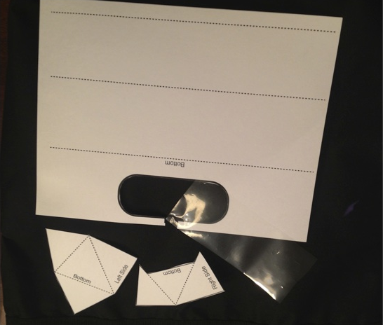
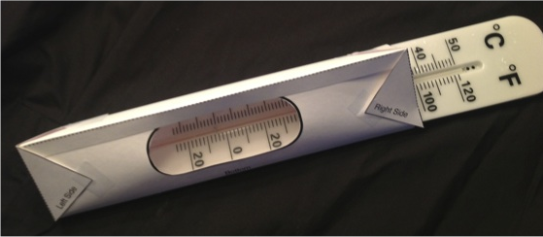

Slide 6
Formative Assessment 2-POE
Predict:
What do you think is going to happen when we place our solar houses outside in the sun?
What do you think will happen to the temperature when we place our solar houses in the shade?

Slide 7
POE
Observe:
The students will take 10 minutes to observe the controlled experiment (the solar house in the sun) and check the temperature every minute.
The students will take the temperature every 10 minutes with the solar house in the shade (or some other variation of the experiment).

Slide 8
POE
Explain:
I will ask the students about their results.
What happened to the solar house with its window facing to the sun?
What happened to the temperature in the solar house when you placed it in the shade?
Why do you think you got the results that you did?
Which experiment was the controlled experiment and which one was the variable?

Slide 9
Results
Before and during the experiment I had the students predict, observe and explain (POE). The students did a great job using their prior knowledge to predict what they thought was going to happen. During the observation period of the lesson and assessment most of the students accurately observed and recorded the temperature from the thermometer and reflected on their predictions and hypothesis. However, at this point they still could not articulate that the sun’s rays are not leaving the solar house and is the reason it is heating up. Finally, the students were able to communicate the results they recorded on a line graph. At this point in the lesson some students are making connections to the greenhouse effect, but most are just able to see the increase in the temperature is made by the sun’s rays. I know by the end of this second formative assessment I will have to teach the green house effect specifically and help the students make connections back to their experiments and the difference in temperature between the controlled and variable results.

Slide 10
Formative Assessment 3- Concept Map
By the end of the third formative assessment, making a Concept Map, the students are able to articulate clearly to me and a friend that the greenhouse effect is when short-wave radiation from sunlight passes freely through the glass and is converted to long-wave radiation inside. But the long-wave radiation cannot pass back out through the glass. The result is a build-up of heat inside the greenhouse from the captured solar energy. I think all of the students progressed in their understanding of this topic, but as with any scientific topic review will be beneficial.

Slide 11
Success!!
I really enjoyed creating this lesson with the formative assessments spread throughout. I thought the lesson seemed more structured and it flowed from one activity to another. I learned that by using formative assessment I am able to keep track of where my students’ understandings are as we go through the lesson. This allowed me to be flexible and more effective in my teaching. Overall, I think that my students met the learning goals that I have hoped they would meet and it is all thanks to three formative assessments.

